Slide 1
Java Programming
Static Methods

Slide 2
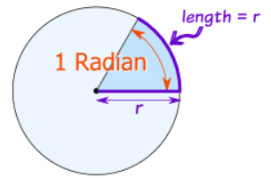
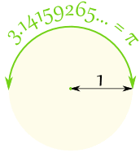
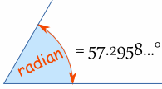
Radians/Degrees

Slide 3
Calculate radians/degrees
From degree to radian
Math. toRadians(180.0);
From radian to degree
Math. toDegrees(Math.PI);

Slide 4
RadianAndDegree.java
package edu.hit.java.intro;
public class RadianAndDegree {
public static void main(String[] args) { double d = Math. toRadians(180.0); System.out.println(d); double r = Math.toDegrees(Math.PI); System.out.println(r);
}
}

Slide 5
Adding new Method
So far we’ve only written short programs that have a single class and a single method (main).
Can we calculate the radians or degrees by calling the methods that are defined by ourselves without using the Math methods?

Slide 6
RadianAndDegree.java (modified)
package edu.hit.java.intro;
public class RadianAndDegree {
public static double toRadians(double degree) {
double radian = degree*Math.PI/180.0;
return radian;
}
public static double toDegrees(double radian) {
double degree= radian*180.0/Math.PI;
return degree;
}
public static void main(String[] args) {…}
}

Slide 7
RadianAndDegree.java (modified)
public static void main(String[] args) { double d = toRadians(180.0); System.out.println(d); double r = toDegrees(Math.PI); System.out.println(r);
}

Slide 8
Static method definition
public static TYPE NAME (TYPE NAME,…) { STATEMENTS return EXPRESSION; }

Slide 9
Parameters & Return Value
Parameters
The variables defined in the parentheses after the method name in the method definition are called parameters (or formal parameters).
The number of the parameters may be more than one.
Return Value
A method that returns a value is called value method, also called function.
A value that a method returns is called return value.
The function return a value of a specified type, called the return type of the function.

Slide 10
Void method
A method without return value is called void method.
The return type of a void method in the definition must be void.
For example, the main method is a void method.

Slide 11
Arguments & parameter passing
Arguments
The values that are passed to a method when it is invoked are called arguments (or actual parameters).
Parameter passing
The process that the argument gets passed from outside the method to the inside is called parameter passing.

Slide 12
Return statement
The value methods must have a return statement at least.
The return statement terminates execution of the function and return a value to the caller.
The return value must match the return type that is specified for the function.
The return statement also allows you to terminate a method before you reach the end of it. I will show you in the next lecture (Conditionals).

Slide 13
Local variable
A variable declared inside a method is called local variable. The parameters are also local variables.
Note :
Local variables cannot be accessed from outside their method.
A local variable declared inside a block cannot be accessed from outside the block.

Slide 14
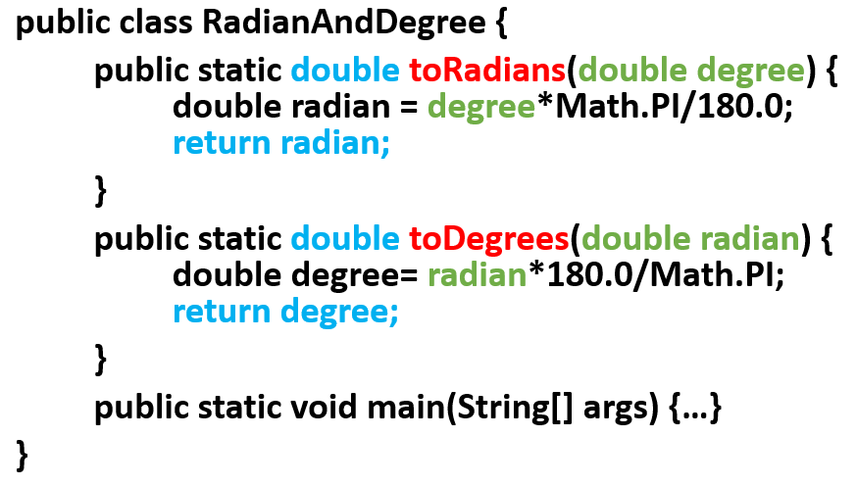
Parameters & Return values
Return type
Parameter
Return type
Parameter
Return value
Return value

Slide 15
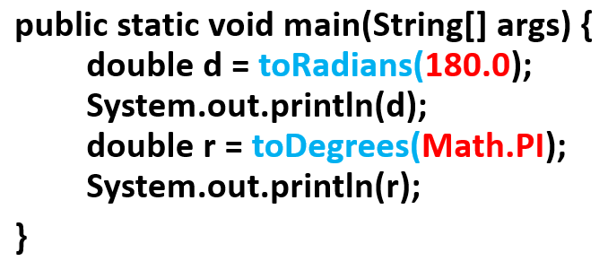
Method invoking & Arguments
Method invoking can be part of a expression
Argument
Argument

Slide 16
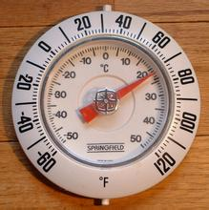
Celsius and Fahrenheit
Define two methods:
Converting Celsius to Fahrenheit
Converting Fahrenheit to Celsius
We have known:
C=(5/9)*(F-32)
F=(9/5)*C+32

Slide 17
Celsius and Fahrenheit
package edu.hit.java.intro;
public class CelsiusAndFahrenheit {
public static double toFahrenheit(double celsius) {
double fahrenheit = celsius*(9/5)+32;
return fahrenheit ;
}
public static double toCelsius(double fahrenheit) {
double celsius= (5/9)*(fahrenheit -32);
return celsius;
}
public static void main(String[] args) {…}
}

Slide 18
Celsius and Fahrenheit
public static void main(String[] args) {
double d = toFahrenheit(-26);
System.out.println(d);
double r = toCelsius(60);
System.out.println(r);
}

Slide 19
Non-static methods
A method can be defined without the static keyword.
If we want to access the non-static methods, we must use the keyword new followed by a call to the class's constructor to instantiate an object, and then use the dot notation to invoke them.
Note: constructor is a special method whose name is same with the name of the class. If you didn’t define the constructor method, the compiler will help you define it.

Slide 20
Celsius and Fahrenheit
package edu.hit.java.intro;
public class CelsiusAndFahrenheit {
public double toFahrenheit(double celsius) {
double fahrenheit = celsius*(9/5)+32;
return fahrenheit ;
}
public double toCelsius(double fahrenheit) {
double celsius= (5/9)*(fahrenheit -32);
return celsius;
}
public static void main(String[] args) {…}
}

Slide 21
Celsius and Fahrenheit
public static void main(String[] args) {
CelsiusAndFahrenheit cf = new CelsiusAndFahrenheit();
double d = cf.toFahrenheit(-26);
System.out.println(d);
double r = cf.toCelsius(60);
System.out.println(r);
}

Slide 22
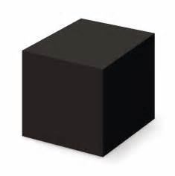
Advantages of methods
Method is also called subroutine, or function.
A method should do one thing and only one thing.
Big programs are built out of small methods.
Methods can be individually developed, tested and reused.
User of method does not need to know how it works (a method seems to be a black box).

Slide 23
Some useful functions
Getting the running time of your program
Getting the current time with specified format
Generating random numbers

Slide 24
Getting the running time
long start=System.currentTimeMillis();
//write your code here
…
end=System.currentTimeMillis();
System.out.println(“your program spent "+(end-start)+"ms");

Slide 25
Getting current time
package edu.hit.java.method;
import java.util.Date;
import java.text.SimpleDateFormat;
public class CurrentDate {
public static void main(String[] args) {
SimpleDateFormat df = new
SimpleDateFormat("yyyy-MM-dd HH:mm:ss");
System.out.println(df.format(new Date()));
}
}

Slide 26
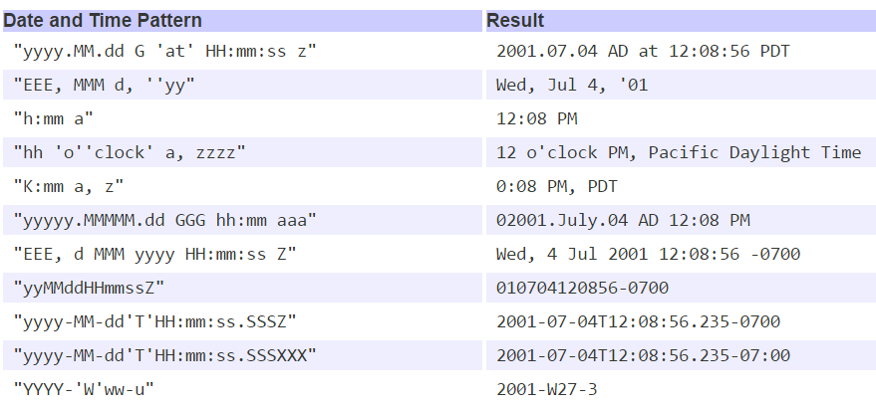
Date and time pattern

Slide 27
New Date and time API of Java 8
There are some disadvantages in the old version of date-time related classes, so Java 8 introduces some new classes (in the package java.time) to process date and time.
Reading materials:
http://www.oracle.com/technetwork/articles/java/jf14-date-time-2125367.html
http://tutorials.jenkov.com/java-date-time/index.html
http://www.codeceo.com/article/java-8-date-time-api.html

Slide 28
Getting current time
Package edu.hit.java.method;
import java.time.LocalDateTime;
import java.time.format.DateTimeFormatter;
public class NewCurrentDate {
public static void main(String[] args) {
//getting current Date and Time
LocalDateTime dateTime = LocalDateTime.now();
//specific format
System.out.println(dateTime.format(
DateTimeFormatter.ofPattern("yyyy-MM-dd HH:mm:ss ")));
}
}

Slide 29
Generating random numbers
There are two principal means of generating random (really pseudo-random) numbers:
the static method Math.random() generates doubles between 0 (inclusive) and 1 (exclusive).
the java.util.Random class generates random integers, doubles, longs and so on, in various ranges.
By invoke its nextXXX() methods, such as, nextFloat(), nextInt(), nextInt(int n), etc.

Slide 30
Math.random()
Returns a double value with a positive sign, greater than or equal to 0.0 and less than 1.0.
Returned values are chosen pseudorandomly with (approximately) uniform distribution from that range.
When this method is first called, it creates a single new pseudorandom-number generator, exactly as if by the expression
new java.util.Random();

Slide 31
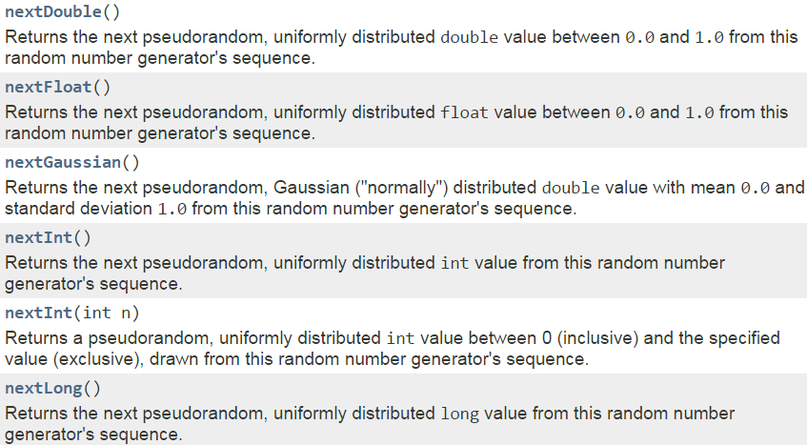
java.util.Random
An instance of this class is used to generate a stream of pseudorandom numbers.

Slide 32
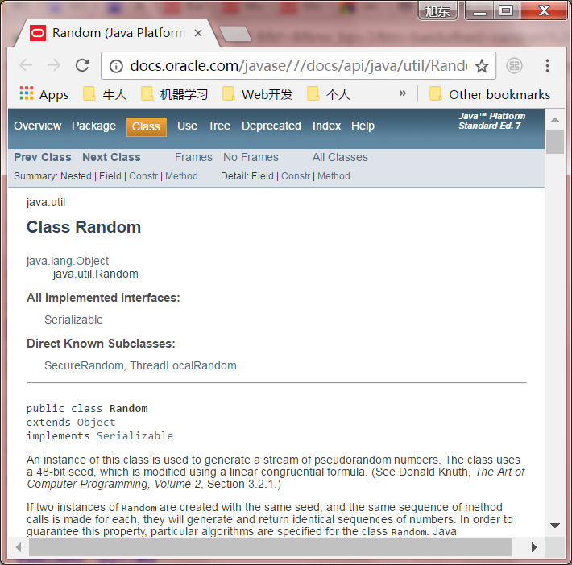
Java API reference
http://docs.oracle.com/javase/7/docs/api/index.html

Slide 33
Quiz 3
Refactor the CalcArea.java
Add a static value method calcCircleArea to calculate the area of a circle.
Add a non-static value method calcRectangleArea to calculate the area of a rectangle.
Modify the main method, invoke calcCircleArea to find the area of a circle with radius 10, invoke calcRectangleArea to find the area of a rectangle with length10 and width 20, and print the results.

Slide 34
Can a method call itself?

Slide 35


